Slide 1
CApStone Project-1
Movie rental data analysis
- Rohan Deshmukh

Slide 2
Business objective
Movie On Rent is a chain of movie rental stores operating in a certain country It has a vast collection of movies in DVD and Blue Ray disc formats. The management of the company wants to analyze what kind of movies are most often rented, which genres they belong to, and which actors appeared in them. It will help the management stock up the inventory as per audience's preferences for improved business

Slide 3
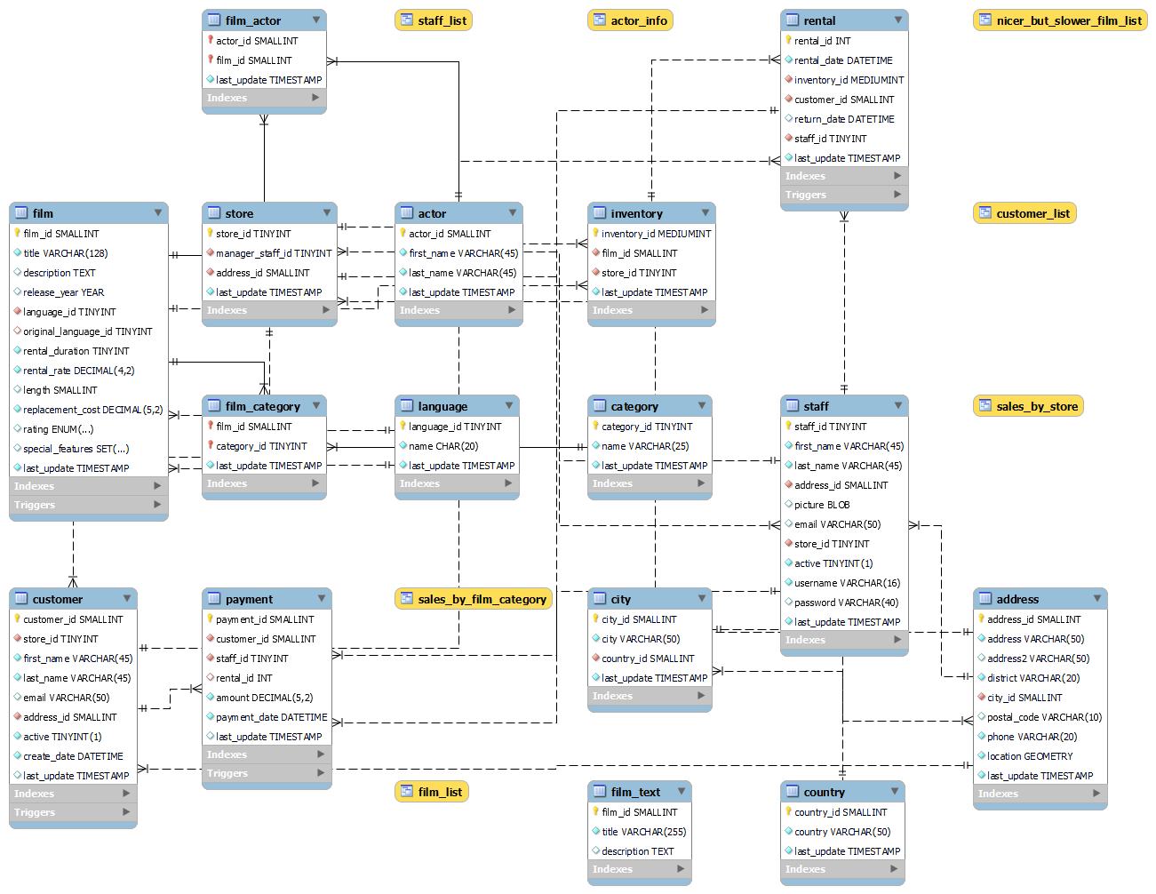
SAKILA DATABASE Er diagram

Slide 4
Problem statements
Task 1: Display the full names of actors available in the database.
Task 2 Management wants to know if there are any names of the actors appearing frequently.
Display the number of times each first name appears in the database.
What is the count of actors that have unique first names in the database? Display the first names of all these actors.
Task 3: The management is interested to analyze the similarity in the last names of the actors
Display the number of times each last name appears in the database.
Display all unique last names in the database.
Task 4: The management wants to analyze the movies based on their ratings to determine if they are suitable for kids or some parental assistance is required. Perform the following tasks to perform the required analysis.
Display the list of records for the movies with the rating "R" (The movies with the rating "R" are not suitable for audience under 17 years of age).
Display the list of records for the movies that are not rated "R".
Display the list of records for the movies that are suitable for audience below 13 years of age
Task 5: The board members want to understand the replacement cost of a movie copy(disc - DVD/Blue Ray). The replacement cost refers to the amount charged to the customer if the movie disc is not returned or is returned in a damaged state.
Display the list of records for the movies where the replacement cost is up to $11.
Display the list of records for the movies where the replacement cost is between $11 and $20.
Display the list of records for the all movies in descending order of their replacement costs.
Task 6: Display the names of the top 3 movies with the greatest number of actors.
Task 7. 'Music of Queen' and 'Kris Kristofferson' have seen an unlikely resurgence. As an unintended consequence, films starting with the letters 'K' and 'Q' have also soared in popularity. Display the titles of the movies starting with the letters 'K' and ‘Q
Task 8: The film 'Agent Truman' has been a great success. Display the names of all actors who appeared in this film.
Task 9: Sales have been lagging among young families, so the management wants to promote family movies Identify all the movies categorized as family films.
Task 10: The management wants to observe the rental rates and rental frequencies(Number of time the movie disc is rented).
Display the maximum, minimum, and average rental rates of movies based on their ratings. The output must be sorted in descending order of the average rental rates.
Display the movies in descending order of their rental frequencies, so the management can maintain more copies of those movies
Task 11: In how many film categories, the difference between the average film replacement cost ((disc-DVD/Blue Ray) and the average film rental rate is greater than $15?Display the list of all film categories identified above, along with the corresponding average film replacement cost and average film rental rate.
Task 12: Display the film categories in which the number of movies is greater than 70.

Slide 5
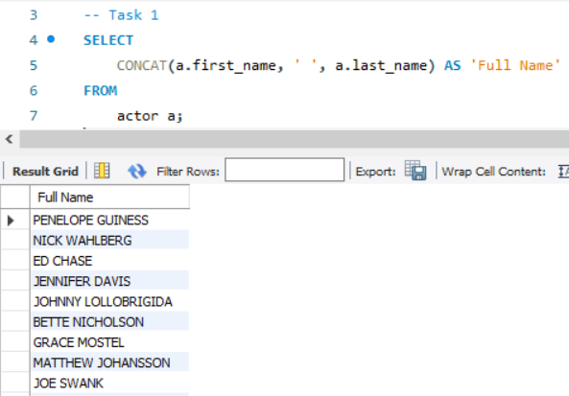
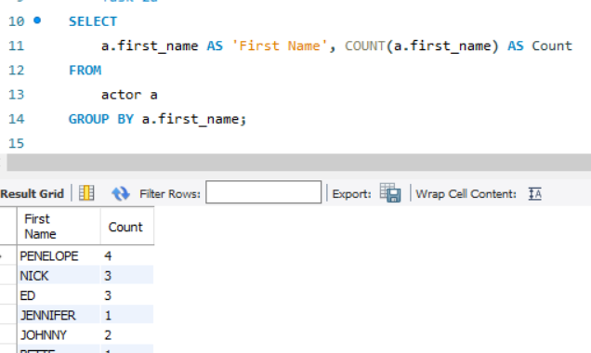
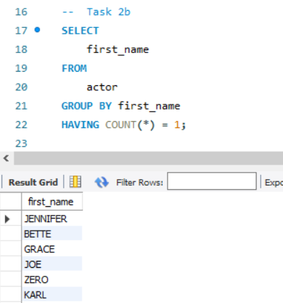
Task 1
Task 2 a
Task 2 b
After concating first_name and last_name we have got 200 rows means there are 200 name in the list
There are around 76 unique names in the table
We got around 128 rows means around 72 names are repeating

Slide 6
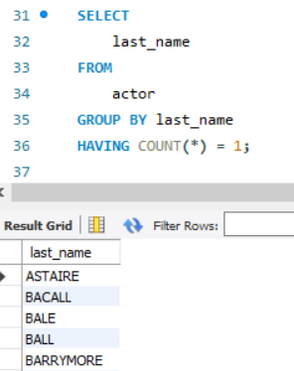
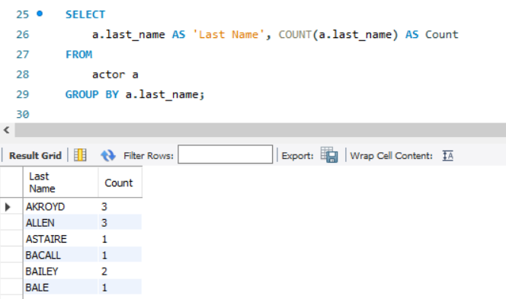
Task 3b
Task 3a
We got around 121 rows means around 79 names are repeating
There are around 66 unique names in the table

Slide 7
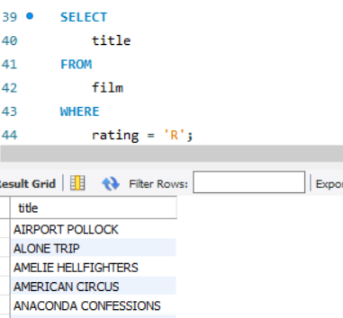
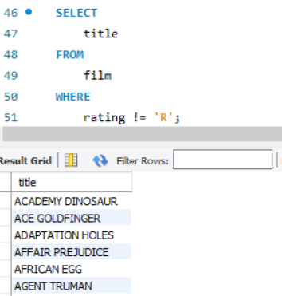
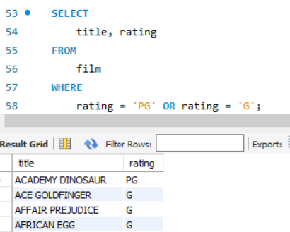
Task 4 a
Task 4 b
Task 4 c
There are Total 195 R Rating Movies
There are 805 Non R rating Movies
There are 372 PG and G rating Movies

Slide 8
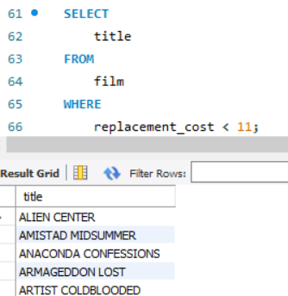
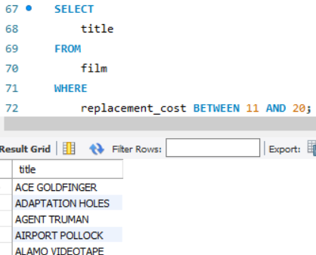
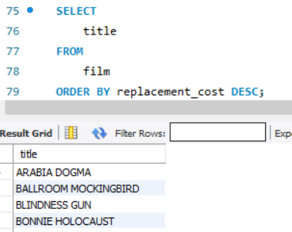
Task 5 a
Task 5 b
Task 5 c
There are Total 90 movies whose Rental cost is less than 11$
There are 424 Movies whose Replacement cost is between 11$ and 20$
We use order by to arrange data in ascending order based on replacement cost

Slide 9
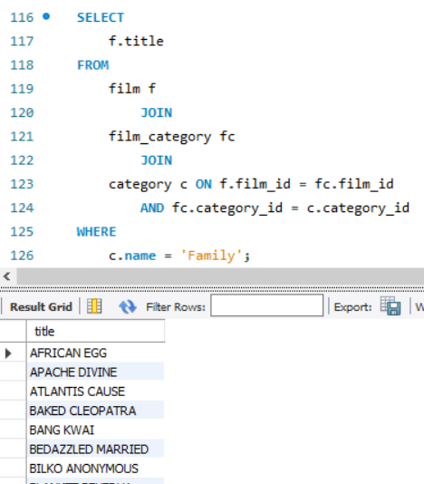
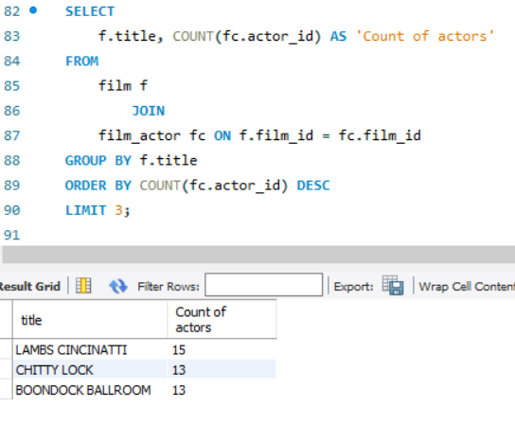
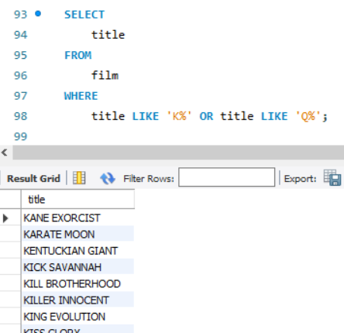
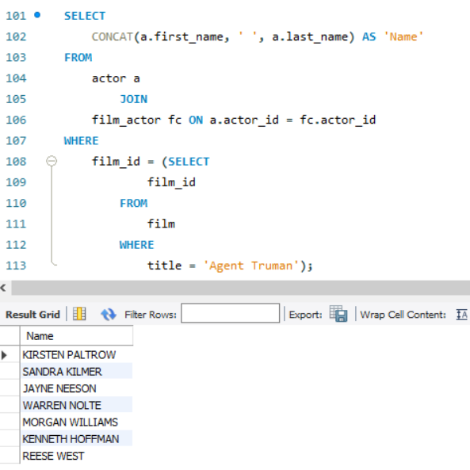
Task 7
Task 9
Task 6
Task 8
These are the top 3 movies
There are total 15 movie title whose initials start from K or Q
There are Total 7 Actors in Agent Truman movie
There are total 69 movies with Family category

Slide 10
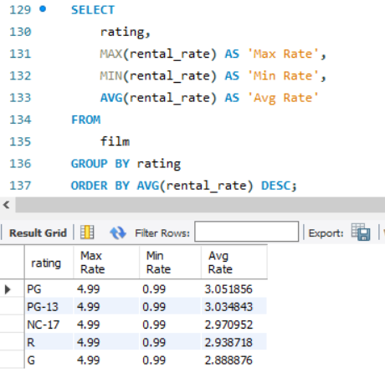
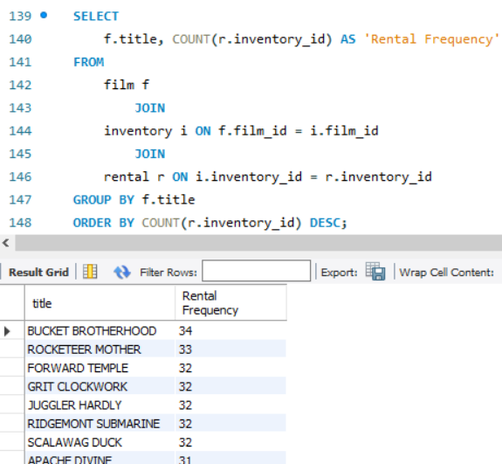
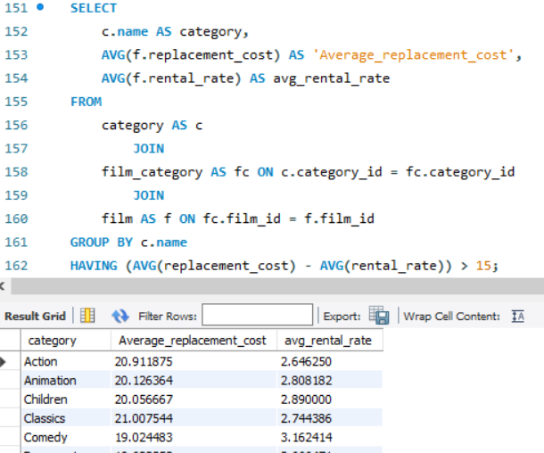
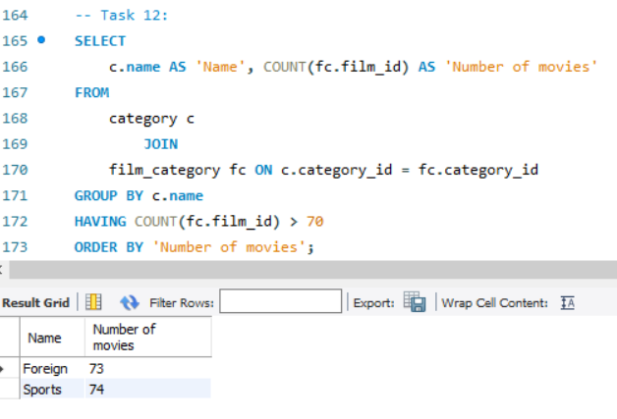
Task 10 a
Task 11
Task 12
Task 10 b
Task 8
Over here we are displaying min max and average rental rate for each rating
There are total 958 movies with Rental Frequency
We get Average rental cost and average rental rate for each category
We got 2 category with movie more than 70 which are Foreign and Sports

Slide 11
Conclusions
There are 200 unique names in the list.
There are 79 unique movies in the table.
There are 958 movies with rental frequency.
The most popular genres are Foreign and Sports
Rental rates range from $0.99 to $4.99.
Foreign movies having the highest rates.

Slide 12
Thank you

